Slide 1
Subject Introduction
Premanand S
Assistant Professor
School of Electronics Engineering
Vellore Institute of Technology, Chennai Campus

Slide 2
Course details
Course Name: Computer Programming: Python
Course Code: BCSE101E
Class Id: CH2023241700193 / CH2023241700191
Slot details: TD1 ( AB1-702) / L45+L46+L57+L58 (AB1 – 505a)
Credits: 2 + 1

Slide 3
**Facts**
Pre-requisite : Interest & Time
Outcome : Base for your future

Slide 4
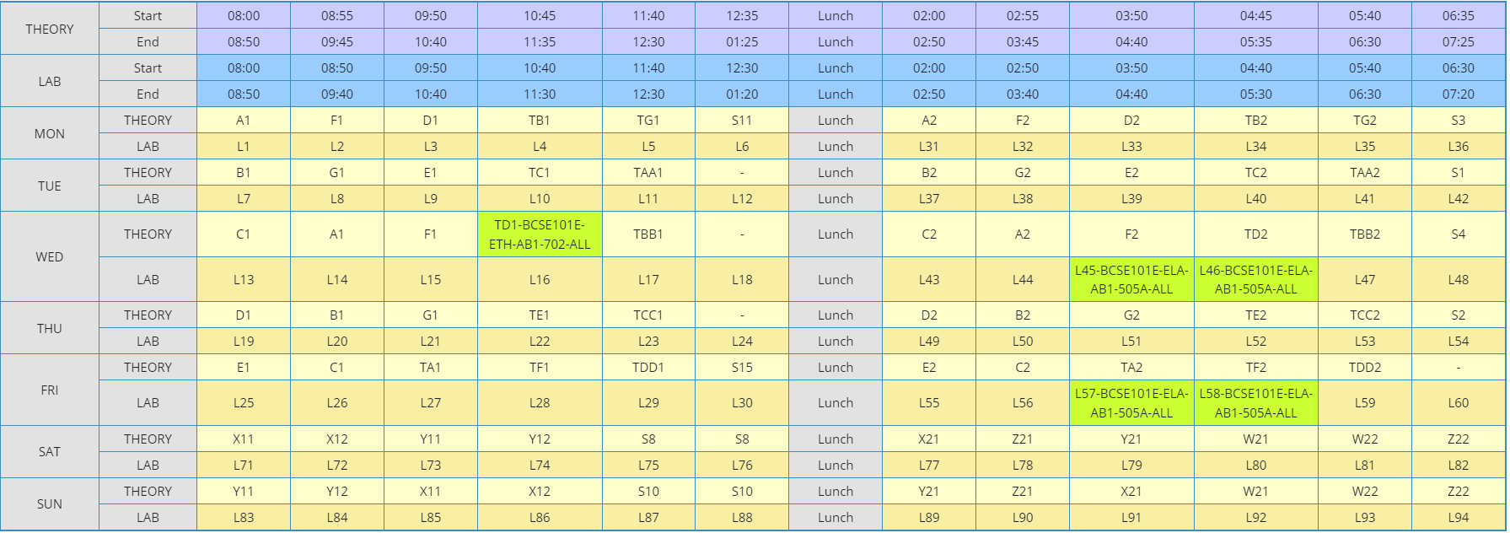
Slot details

Slide 5
Some basic Q’s
Why ? – Importance
What ? – Purpose
How? – Language
Where? – Domain
Who? – Can learn
When? - Helpful

Slide 6
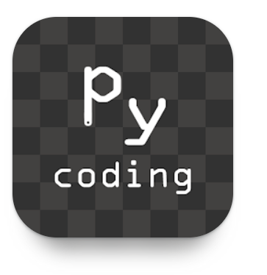
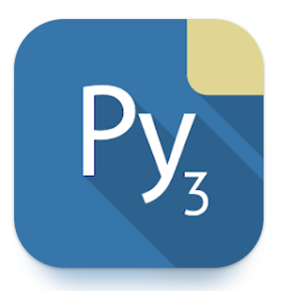
Platform
Google Collaboratory
Anaconda Navigator platform – Jupyter NB
Thonny IDE, Visual Studio code.
Coding Python - https://play.google.com/store/apps/details?id=com.kvassyu.coding.py&hl=en&gl=US&pli=1
Pydroid3 - https://play.google.com/store/apps/details?id=ru.iiec.pydroid3&hl=en&gl=US

Slide 7
Vpropel
Vpropel - https://www.youtube.com/watch?v=VIS2D0NDUsk&list=PLm5_00Fh3DQyPO_4W-HocBtSoJX0UXqUo

Slide 8
Module details

Slide 9
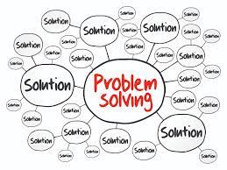
Module 1 Introduction to Problem Solving
Problem solving: Definition and Steps
Problem Analysis Chart (PAC)
Developing an Algorithm
Flowchart
Pseudocode

Slide 10
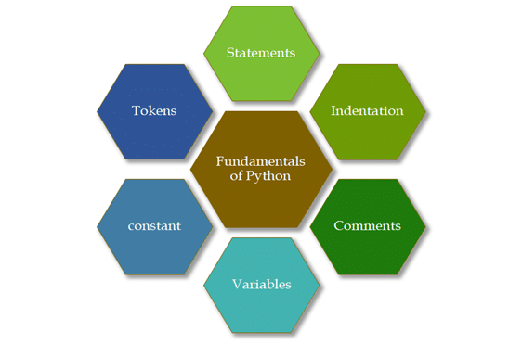
Module 2 Python Programming Fundamentals
Introduction to Python
Interactive and Script mode
Indentation
Comments
Variables
Reserved words
Data Types
Operators and their precedence
Expressions
Built in functions
Importing from packages

Slide 11
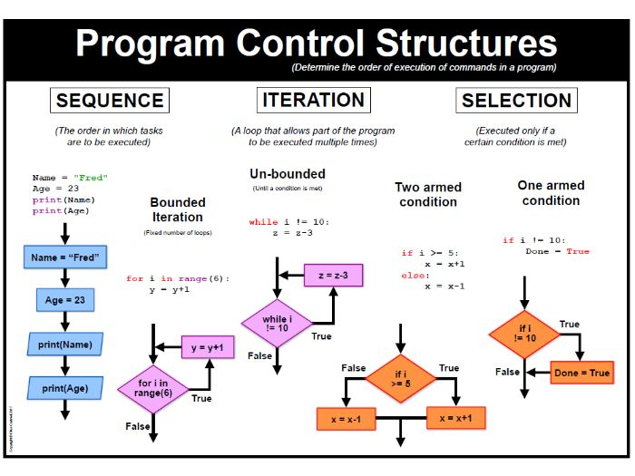
Module 3 Control Structures
Decision making and Branching
If, if – else, nested if, multi-way if-elif statements
Looping
While loop
For loop
Else clauses in loop
Nested loops
Break
Continue
Pass statements

Slide 12
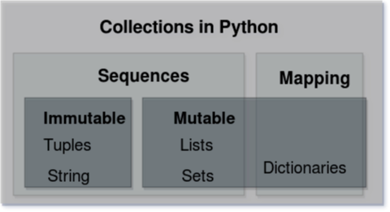
Module 4 Collections
Lists: Create, Access, Slicing, Negative indices
List methods
List comprehensions
Tuples : Create, Indexing, Slicing, Operation on tuples
Dictionary: Create, add and replace values, operations on dictionary
Sets: Creation and operations

Slide 13
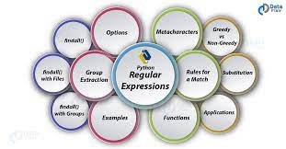
Module 5 Strings and Regular Expressions
Strings: Comparison, Formatting, Slicing, Splitting, Stripping
Regular Expressions: Matching, Search and Replace
Patterns

Slide 14
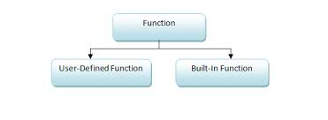
Module 6: Function and Files
Functions – Parameters and Arguments: Positional arguments, Keyword arguments, Parameters with default values
Local and Global scope of variables
Functions with Arbitrary arguments
Recursive Functions
Lambda Function
Files: Create, Open, Read, Write, Append and Close – tell and seek methods

Slide 15
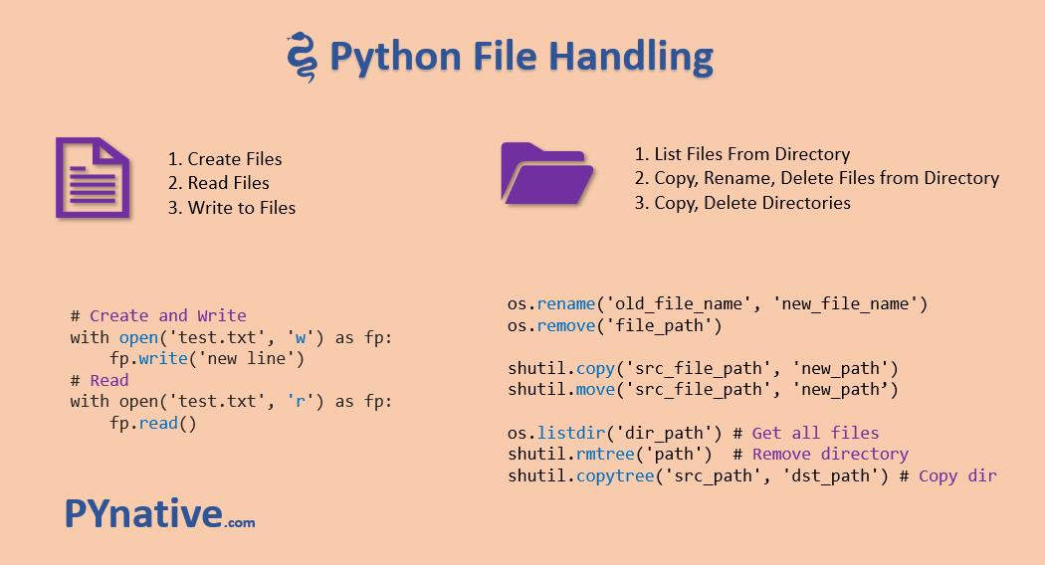
Files

Slide 16
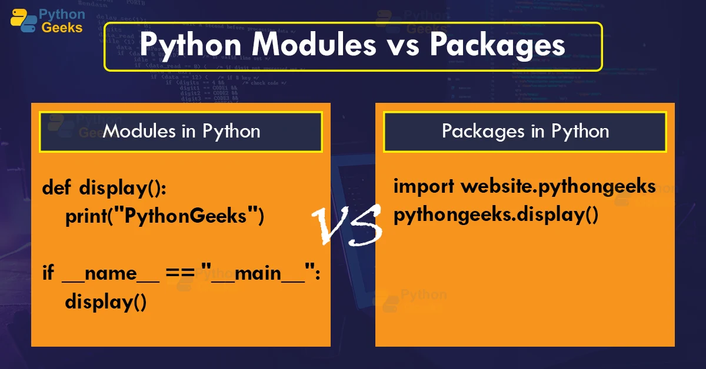
Module 7: Modules and Packages
Built-in modules
User-Defined modules
Overview of NumPy library
Overview of Pandas library

Slide 17
Prescribed books

Slide 18
Books
Eric Matthes, Python Crash Course: A Hands-On, Project-Based Introduction to Programming, 2nd Edition, No starch Press, 2019 (https://www.amazon.in/Python-Crash-Course-Eric-Matthes/dp/1593279280) or https://z-lib.org (E-books)
Martic C Brown, Python: The Complete Reference, 4th Edition, McGraw Hill Publishers, 2018. (https://www.amazon.in/Python-Complete-Reference-Martin-Brown/dp/9387572943 )
John V. Guttag, Introduction to computation and programming using python: with applications to understanding data. 2nd Edition, MIT Press, 2016. (https://www.amazon.in/Introduction-Computation-Programming-Using-Python/dp/0262529629 )

Slide 19
Mastering Python?

Slide 20
Mastery materials
Python for Everybody Specialization – Charles Russell Severance (https://www.youtube.com/watch?v=8DvywoWv6fI&t=8s ) 13:40:09
Udemy – 100 Days of code: The complete Python Pro Bootcamp for 2023 – Dr Angela Yu (https://www.udemy.com/course/100-days-of-code/learn/lecture/17841330?start=0#overview )

Slide 21
So why this subject in SENSE?
Future – Python programming language
Technology – Artificial Intelligence (Machine Learning, Deep Learning)
Image Processing (Computer Vision), Signal Processing (Health Care), VLSI, Nano-materials (Sensors, IoT) and so on…
Versatility – General Purpose (Data Analytics, Game development, Web Development, Web Scarping, Scripting, Data Science & Visualization, AI, SEO, GUI)

Slide 22
How to engage with Python?
Many competitions, hackathon – Globally
Learn and Earn (Out of University)
Writing – Blogathon – Analytics Vidya
Teach – YouTube
Professionalism – Udemy, Freecodecamp
Networking – LinkedIn, Twitter
Participate & Practice - Kaggle
Freelancing
Website & GitHub repositories

Slide 23
Some reasons to study Python
Ample of Opportunities in Python
Good Remuneration
Popular Among Start-ups
Quick to Learn
Learn The Basic For Free
High Demand
It is Highly Adaptable
Front-end And Back-end of Projects Works Better
Python Makes “OUT OF THE BOX” Possible

Slide 24
Laboratory experiments

Slide 25
Experiments
Problem Analysis Chart, Flowchart and Pseudocode Practices.
Sequential Constructs using Python Operators, Expressions.
Branching (if, if-else, nested if, multi-way if-elif statements) and Looping (for, while, nested looping, break, continue, else in loops).
List, Tuples, Dictionaries & Sets.
Strings, Regular Expressions.
Functions, Lambda, Recursive Functions and Files.
Modules and Packages (NumPy and Pandas)

Slide 26
Laboratory reference books

Slide 27
Mariano Anaya, Clean Code in Python: Develop maintainable and efficient code, 2nd Edition, Packt Publishing Limited, 2021. (https://www.amazon.in/Clean-Code-Python-maintainable-efficient/dp/1800560214 ) or https://z-lib.org (E-books)
Harsh Bhasin, Python for beginners, 1st Edition, New Age International (P) Ltd., 2019 (https://www.amazon.in/Python-Beginners-Harsh-Bhasin/dp/9386649497)

Slide 28
Evaluation details
IPS
PAT
CAT
FAT
BAT

Slide 29
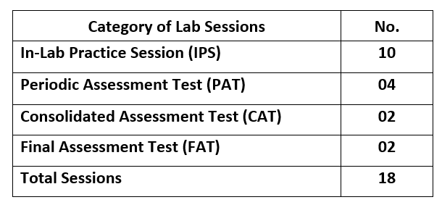
Sessions to be followed,

Slide 30
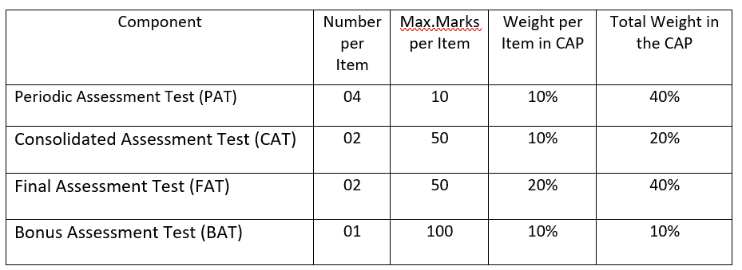
Metrics to be evaluated,

Slide 31
Tentative action plan,
S.No | Week | Name of the Component
1 | Aug 14 - Aug 18 | -
2 | Aug 21 - Aug 25 | IPS 1, IPS 2
3 | Aug 28 - Sep 1 | PAT 1
4 | Sep 4 - Sep 8 | IPS 3, IPS 4
5 | Sep 11 - Sep 15 | -
6 | Sep 18 - Sep 22 | PAT 2, CAT 1
7 | Sep 25 - Sep 29 | IPS 5
8 | Oct 2 - Oct 6 | IPS 6
9 | Oct 9 - Oct 13 | PAT 3
10 | Oct 16 - Oct 20 | -
11 | Oct 23 - Oct 27 | IPS 7, IPS 8
12 | Oct 30 - Nov 3 | PAT 4, IPS 9
13 | Nov 6 - Nov 10 | IPS 10, CAT 2
14 | Nov 13 - Nov 17 | -
15 | Nov 20 - Nov 24 | FAT 1, FAT 2

Slide 32
Inside lab and class
No Phones
Shouldn’t be one side conversation
Notebook

Slide 33
Queries?

